Slide 1
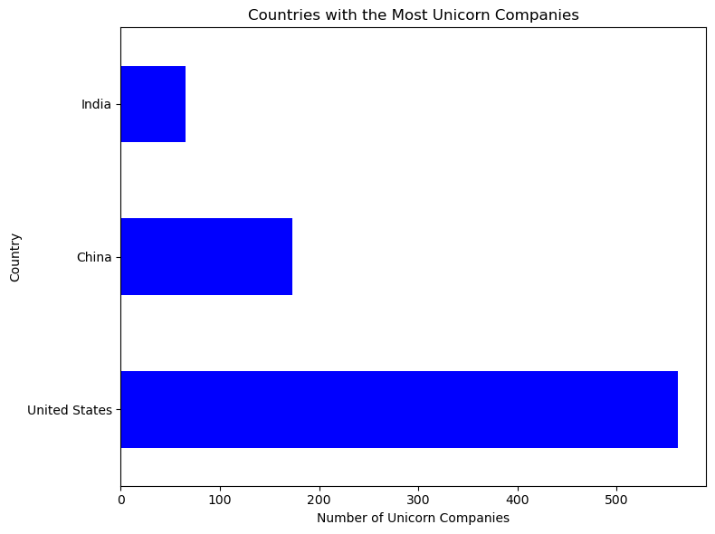
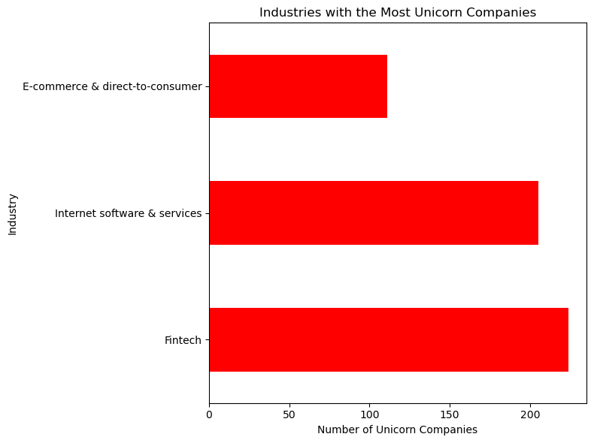
Analysis of 1074 Unicorn companies across global markets - Insights
Largest investor in Unicorns
Country with largest Unicorns
How long does it take a company to become a unicorn
Oldest Unicorn company
Newest Unicorn company
Accel
United States
7.5 years
Otto Bock Healthcare founded in 1919
Yuga Labs founded in 2021
Industries with the largest number of Unicorn companies
Top 3 investors in Unicorn companies

Slide 2
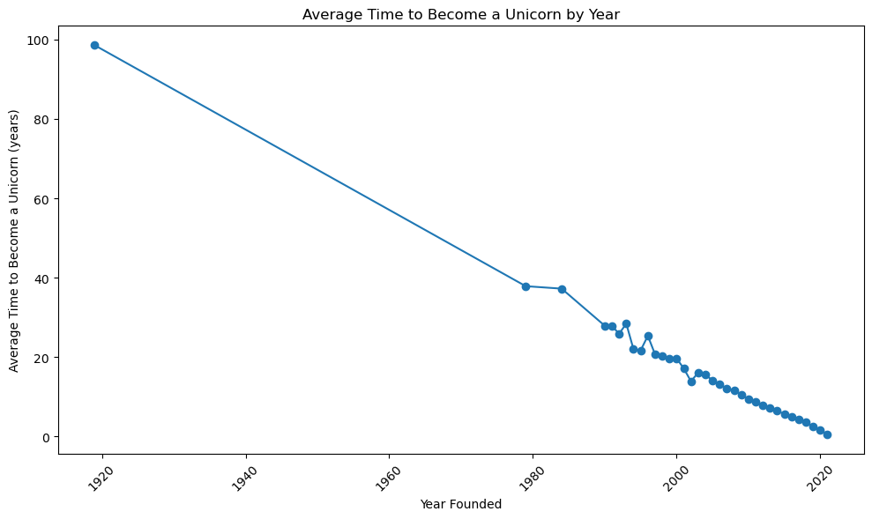
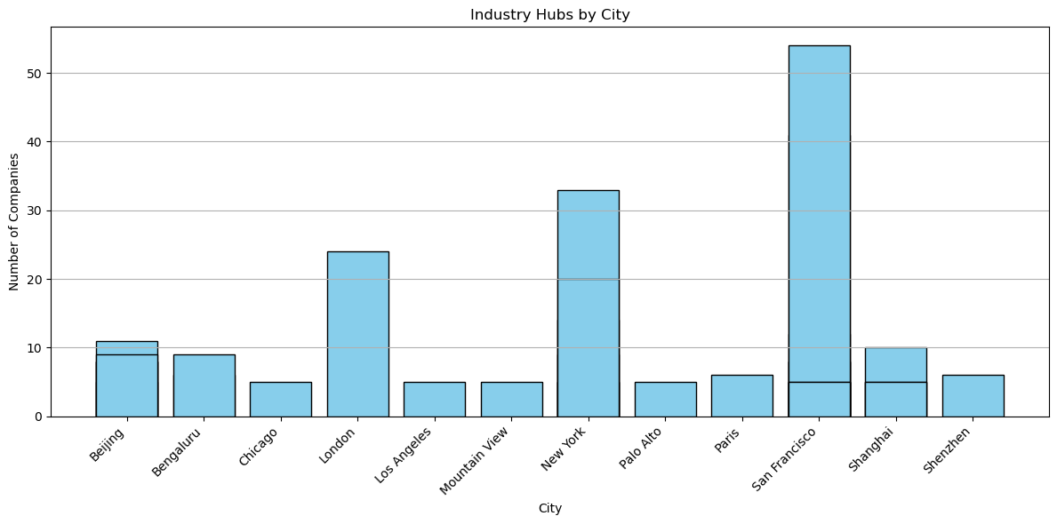
Average time taken to become a Unicorn is 7.5 years
12 Cities are Industrial Hubs, with San Francisco having twice as many companies on London

Slide 3
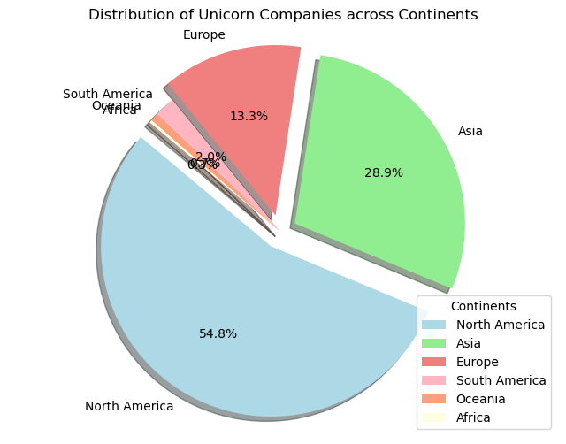
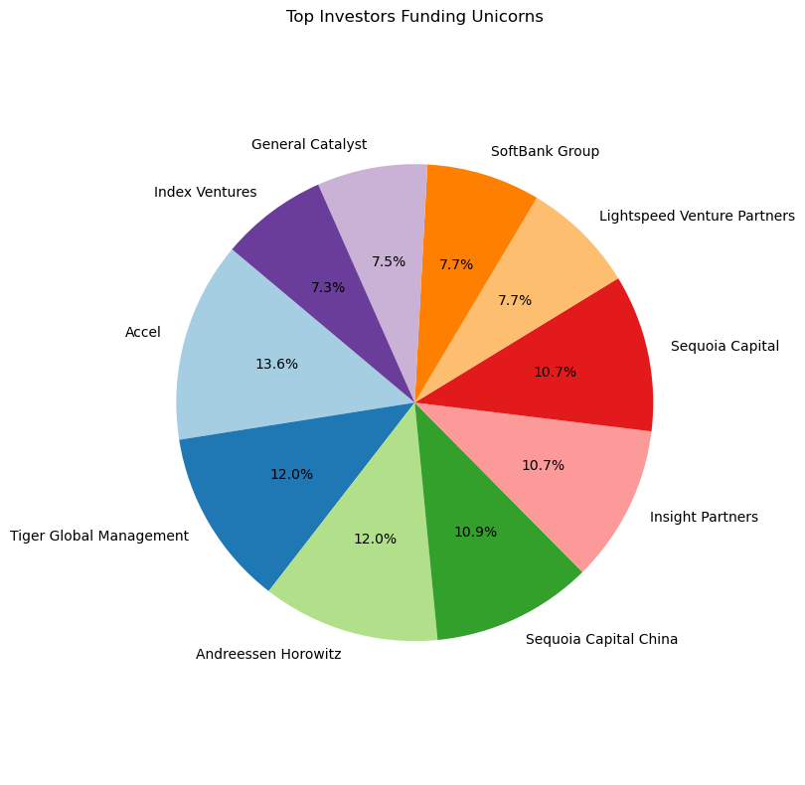
North America has the largest Unicorn companies
Accel is the largest funder as 13.6% of its investments is in Unicorns

Slide 4
Recommendations: It is important for the stakeholders to continue monitoring the market dynamics, remain flexible and make data-driven decisions
Diversify Investment Portfolio:
While Accel, Tiger Global Management, and Andreessen Horowitz are prominent investors in Unicorn companies, stakeholders may consider diversifying their investment portfolio. Exploring opportunities in emerging industries and regions could lead to potentially high-growth investments.
Global Expansion Strategy:
With the United States having the largest portfolio of Unicorns, stakeholders may focus on expanding their business presence and investments in other regions, such as Asia and Europe. This can help tap into new markets and growth opportunities.
Accelerating Growth:
The average time it takes for a company to become a Unicorn is 7.5 years. Stakeholders can work on strategies to accelerate growth and reach Unicorn status faster. This may involve optimizing business operations, seeking strategic partnerships, or implementing innovative marketing techniques.
Exploring Emerging Markets:
The top three countries investing in Unicorn companies are the USA, China, and India. Stakeholders can explore emerging markets with potential for growth to diversify their portfolio and gain a competitive advantage.
Industry-Focused Strategies:
Concentrating on industry hubs, such as San Francisco, can offer valuable insights into trends and competition. Tailoring business strategies based on the specific needs of each industry can help stakeholders better serve their target market.
Seizing Opportunities in Fintech, Internet Software & Services, and E-commerce & DTC:
Fintech, Internet Software & Services, and E-commerce & DTC are leading industries with significant Unicorn representation. Stakeholders may consider investing in or expanding their businesses in these sectors to capitalize on their growth potential.

